Slide 1
Two-Dimensional Kinematics in Rectangular Coordinate Systems
Dr. Jacob Moore
Associate Professor of Engineering
Penn State Mont Alto

Slide 2
Curvilinear Motion
Curvilinear motion is motion that follows a curved path.
Planar motion (2-D Motion) is curvilinear motion that follows a curve in a single plane
So far we have dealt with only a single dimension, but to describe curvilinear motion we will need at least 2 dimensions.
Options for these two dimensions include:
Rectangular (horizontal position and vertical position from a stationary origin)
Normal and Tangential Coordinates (rectangular coordinates that are attached to the object in motion)
Polar Coordinates (angle and magnitude of vector from a stationary origin)

Slide 3
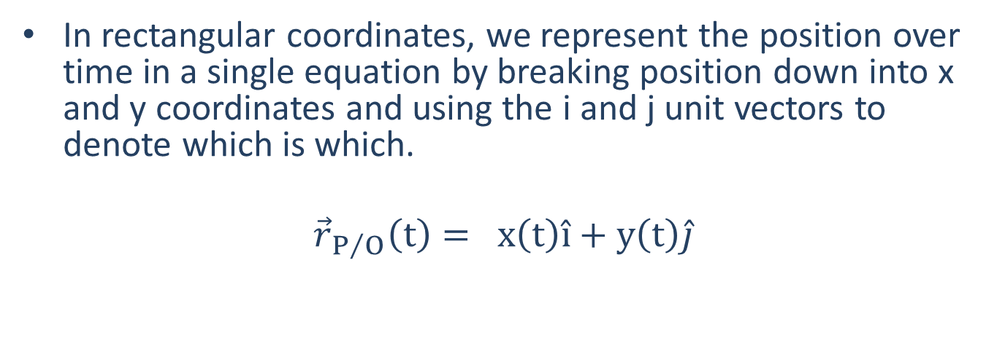





Planar Motion with Rectangular Coordinates
In rectangular coordinates, we represent the position over time in a single equation by breaking position down into x and y coordinates and using the i and j unit vectors to denote which is which.
$${\vec{r}}_{P/O}\left(t\right)= x\left(t\right)\hat{i}+y\left(t\right)\hat{j}$$
y
x
$$p$$
$$\hat{j}$$
$$r$$
y
$$o$$
x
$$\hat{i}$$

Slide 4
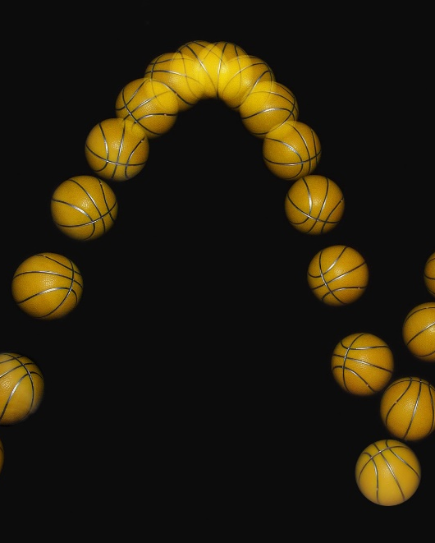
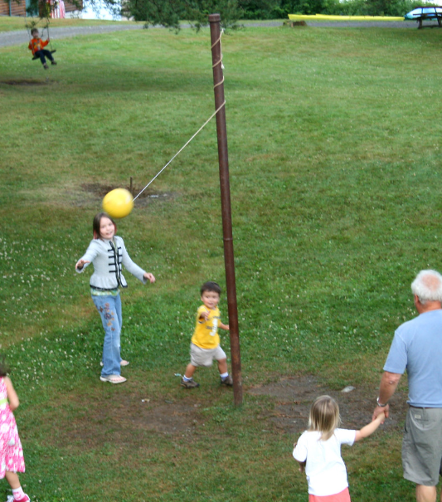
Rectangular Coordinates
To really use rectangular coordinates, we should have “independent” motion.
This means that the direction of forces (and thus accelerations) do not depend upon the position or orientation of the body.
Based on image by MichaelMaggs CC-BY-SA 3.0
Based on image by Paul Schultz CC-BY 2.0

Slide 5
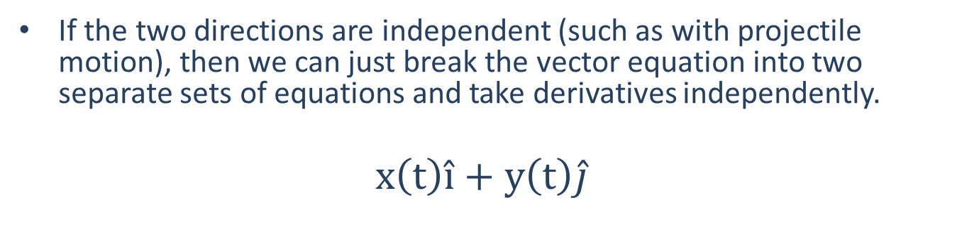
Planar Motion with Rectangular Coordinates
If the two directions are independent (such as with projectile motion), then we can just break the vector equation into two separate sets of equations and take derivatives independently.
$$x\left(t\right)\hat{i}+y\left(t\right)\hat{j}$$
$$x\left(t\right)=…$$
$$\dot{x}\left(t\right)=…$$
$$\ddot{x}\left(t\right)=…$$
$$y\left(t\right)=…$$
$$\dot{y}\left(t\right)=…$$
$$\ddot{y}\left(t\right)=…$$
Time (t) is what ties these two sets of equations together

Slide 6
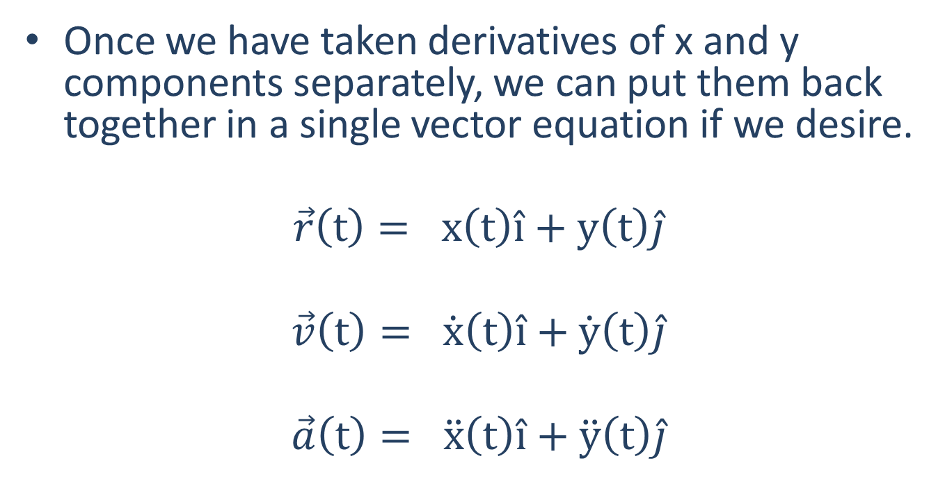
Back to Vector Equations
Once we have taken derivatives of x and y components separately, we can put them back together in a single vector equation if we desire.
$$\vec{r}\left(t\right)= x\left(t\right)\hat{i}+y\left(t\right)\hat{j}$$
$$\vec{v}\left(t\right)= \dot{x}\left(t\right)\hat{i}+\dot{y}\left(t\right)\hat{j}$$
$$\vec{a}\left(t\right)= \ddot{x}\left(t\right)\hat{i}+\ddot{y}\left(t\right)\hat{j}$$

Slide 7
Rectangular Coordinates
To find the overall magnitude of the velocity or acceleration in the end. We can use the Pythagorean Theorem.
$$\overline{v}\left(t\right)=\sqrt{\dot{x}{\left(t\right)}^{2} +{\dot{y}(t)}^{2} }$$
To find the direction we can use the tangent function.
$$θ=\tan^{−1}\left(\frac{\dot{y}(t)}{\dot{x}(t)}\right)$$
$$\dot{x}(t)$$
$$θ$$
$$\dot{y}(t)$$
$$v(t)$$

Slide 8
Thanks for Watching
See other engineering mechanics videos and access the full tool at…

Slide 9





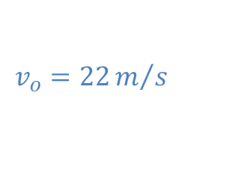
Worked Example
A motorcycle drives off a one-meter-tall ramp at an angle of 30 degrees as shown below. Determine the equations for the acceleration, velocity, and position over time. How far does the motorcycle in the x direction before hitting the ground?
$$y$$
$$v_{o}=22m/s$$
$$30o$$
$$x$$
$$1 m$$

Slide 10








Worked Example
A basketball is thrown towards as hoop that is three feet higher in the y direction and 25 feet away in the x direction. If the ball is thrown at an initial angle of 50 degrees, what must the initial velocity be for the ball to make it into the hoop?
$$y$$
$$v_{o}=?$$
$$3 ft$$
$$50o$$
$$x$$
$$25 ft$$

Slide 11







Worked Example
A tennis ball is launched at an angled surface as shown below such that it will bounce up after impact. The tennis ball has an initial velocity of 30 m/s at a 20-degree angle and is launched 20 meters from the base of the surface, which itself is angled at 45 degrees. Determine the coordinates where the tennis ball is expected to impact the surface.
$$y$$
$$v_{o}=30\frac{m}{s}$$
$$45o$$
$$x$$
$$20o$$
$$20 m$$

Slide 12




Worked Example
You are designing an artillery system with the aim of hitting a target 20 km away with two shells at the same time.
The first shot will be fired at a 50-degree angle. What is the required initial velocity needed to hit the target? Assume air resistance is negligible.
The second shot will be fired five seconds after the first. What is the required initial velocity and angle to hit the target at the same time as the first shot?
$$20 km$$
Projectile 1
$$θ_{1}=50o$$
Projectile 2
$$θ_{2}= ?$$

